Slide 1

Street Children Non-Profit Organization Portfolio Website

Slide 2

Name: Belal Hoshan
ID: 202002060
Section: DB, Batch: 202
Dept. Of CSE
Green university of Bangladesh
Name: Subrato Basak
ID: 202002053
Section: DB, Batch: 202
Dept. Of CSE
Green university of Bangladesh

Slide 3
Content
• Introduction.
• Project Aims.
• Tools & Technologies
• Project Overview.
• Future scope.
• Conclusion.

Slide 4
Introduction
Street children in Bangladesh live in extreme poverty, and do not have sufficient access to human rights such as education, housing, healthcare, and protection. According to the Bangladesh Institute of Development Studies, there were over 1.5 million street children in Bangladesh in 2015, with further estimates suggesting this could rise to 1.6 million by 2024. For children, particularly in Dhaka, organized crime is a reality. Rather than receiving protection by those in authority, they have been led into a life of petty theft, sexual exploitation, drug taking, and are frequently subject to beatings, arrest and imprisonment.

Slide 5
Project Aims
This project works with street children, civil society and the government to create change and improve the quality of street children’s lives and their access to education, healthcare, shelter and safe employment opportunities. The project aims to give these children some of the basic care which they are entitled to but not provided presently by society and provide them respect and support in their difficult lives

Slide 6
Tools & Technologies
The tools and technologies we will use in this project are,
HTML, CSS, PHP, JavaScript for webpage developing.
MySQL for Database.
XAMPP for Localhost Server.
PC/ Laptop.
Sublime Text / VS / Notepad++ (editor).

Slide 7
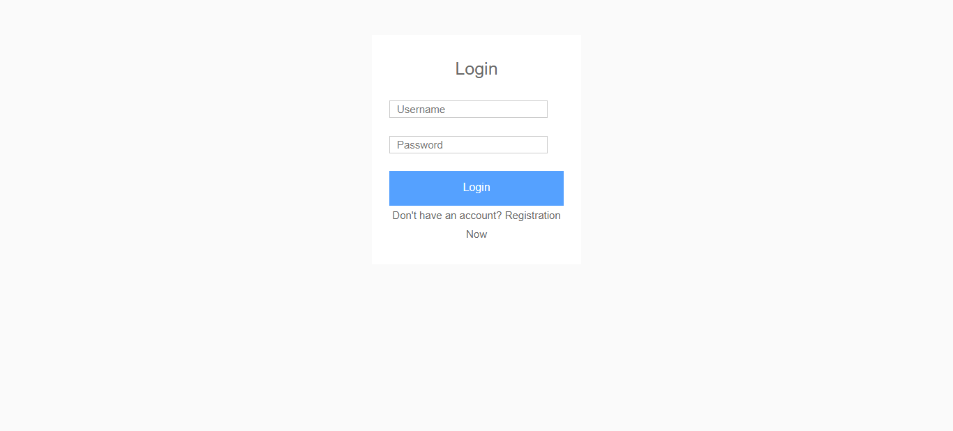
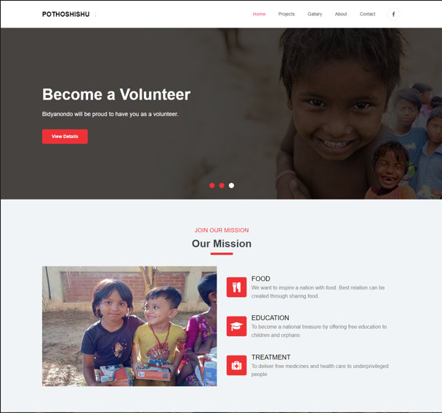
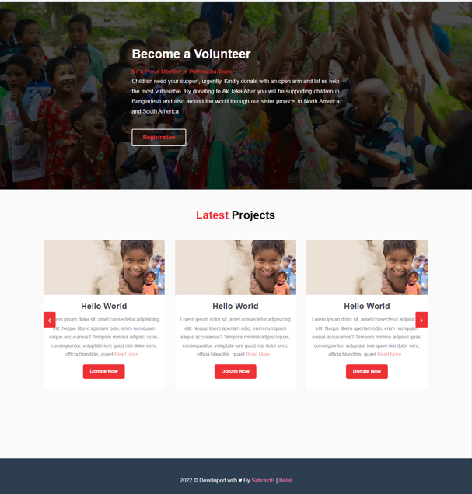
Project Overview

Slide 8
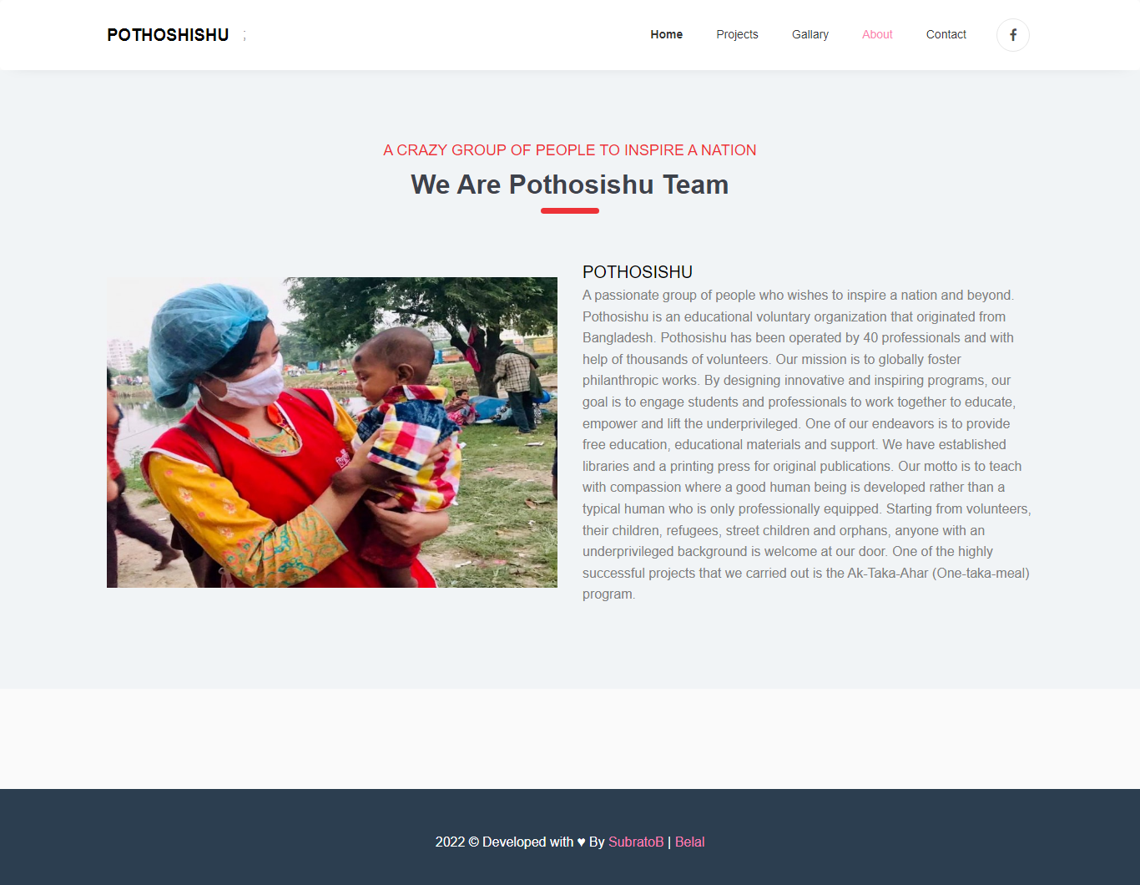
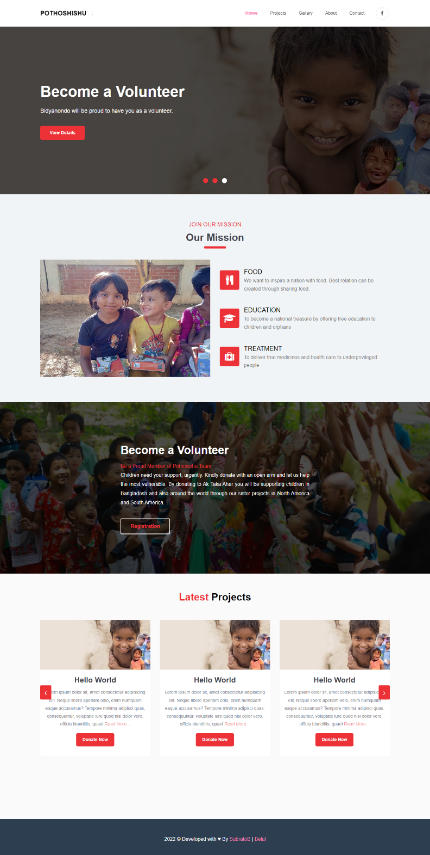
Project Overview

Slide 9
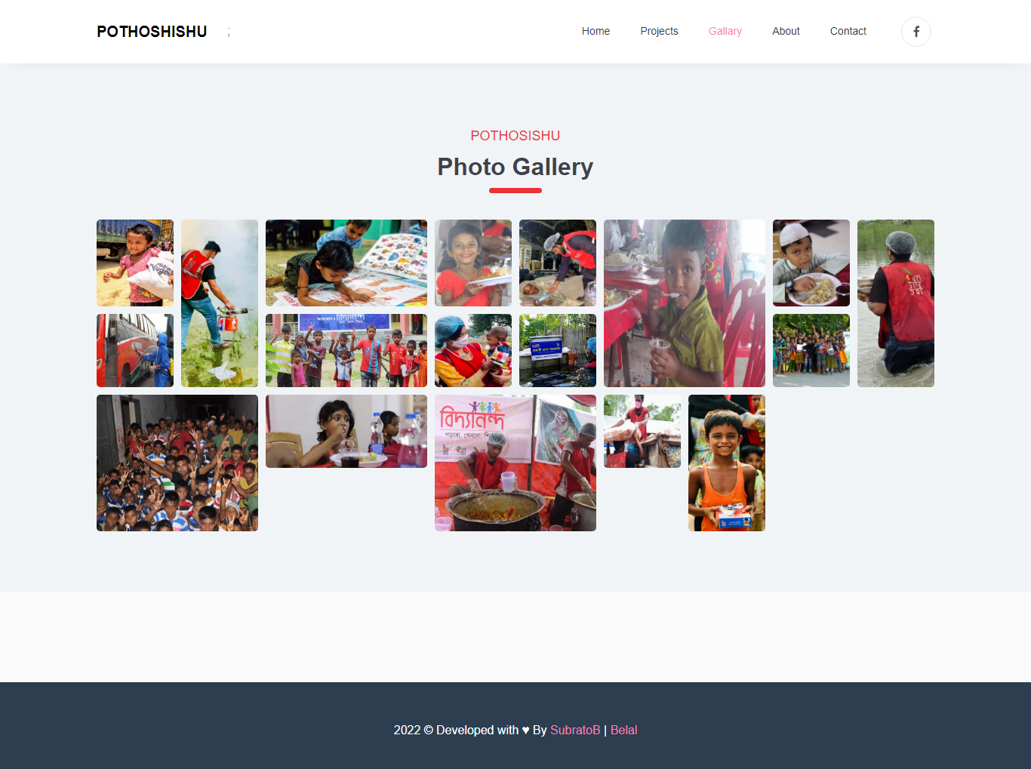
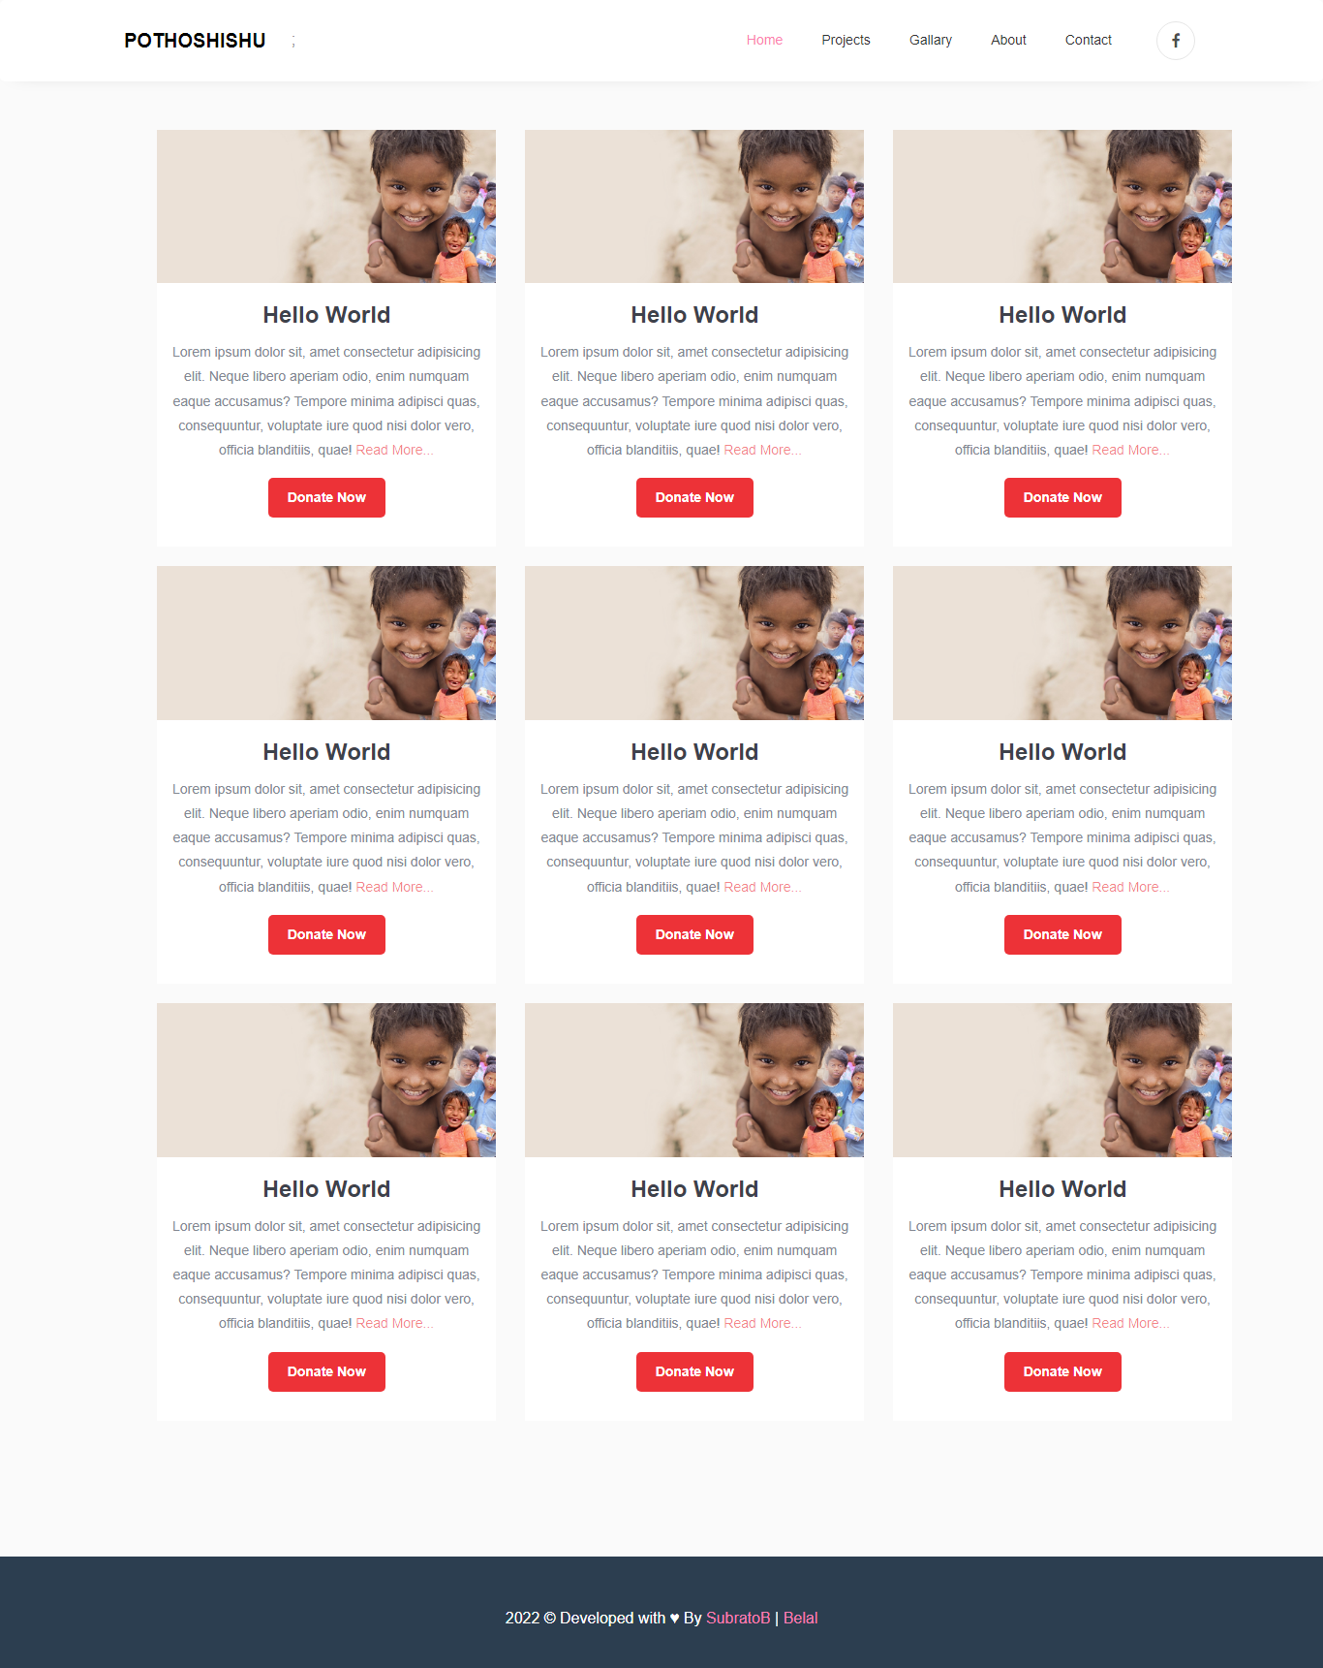
Project Overview

Slide 10
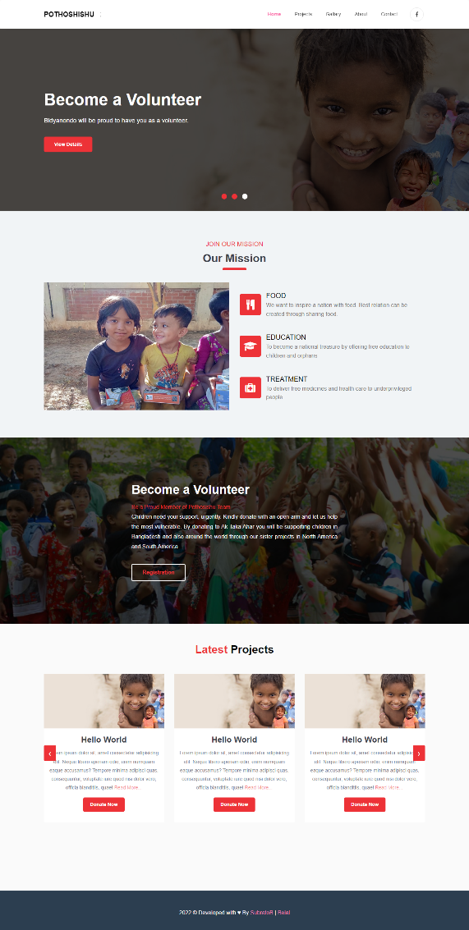
Project Overview

Slide 11

Thank you ma’am ❗
Any Question❓

